Slide 1
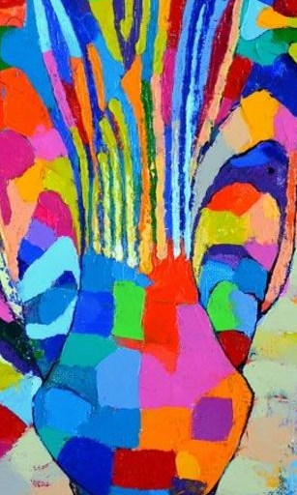
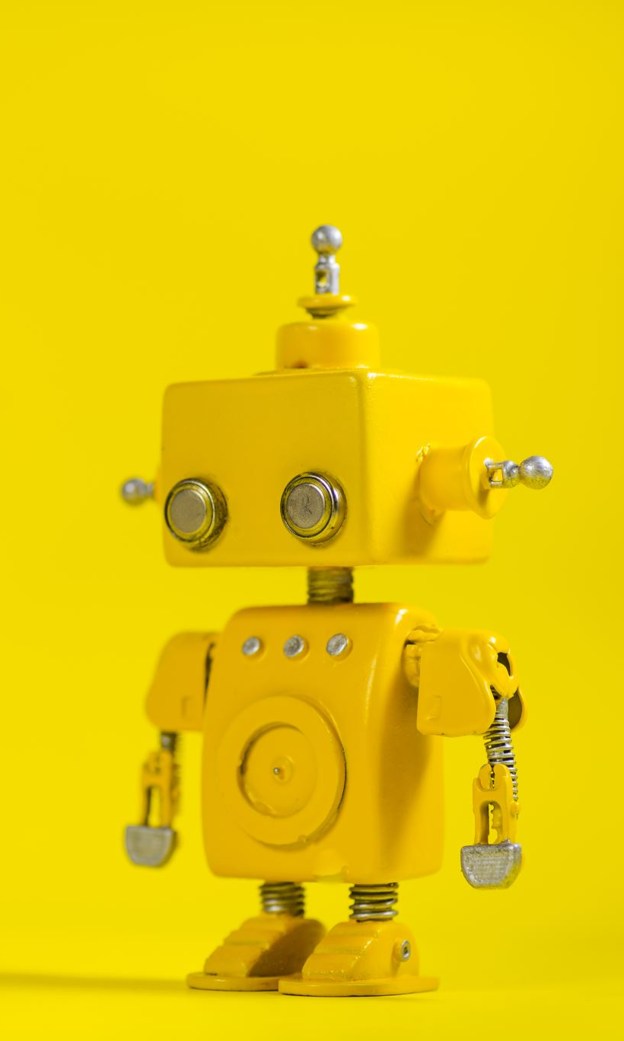
Improving Logo Generation with Machine Learning and Artificial Intelligence by Approximating the Logo Design Process
Mohammed Alfaez
Richard Anton
Bernardo Margulis

Slide 2
Abstract
Logo creation is a complex and expansive problem for artificial intelligence. There are several complications, some technical such as lack of hierarchy and lack of continuous space, as well as design complications, such as the difficulty of selecting a typeface or color. However, given that producing a logo is time- and resource-intensive, using artificial intelligence to expedite the process is an attractive challenge. There are currently three types of logo generation AI: one set asks the user to select from a set of icons, colors, and typefaces and iterates over layouts; these designs are aesthetically pleasing, but lack content or meaning, and the user is tasked with making most of the choices. The second set uses a collection of images to synthesize a new image; the resulting graphics are often non-representational and low-quality, and the logos don’t include text. A third method relies on pre-designed logos and focuses on style transfer; this makes for visually interesting logos, but relies on the user inputting a base logo. We propose a new type of logo generation AI that better approximates the logo design process by asking the user to input attributes they would like to impose on the logo. We use these attributes to produce a content and a style image from pre-trained datasets, and we use synonym expansion if we don’t get a direct match. Using style transfer, we produce an image that we then combine with text. By following a simplified version of the logo design process, the result is a visually pleasing logo that is usable and recognizable, and includes meaning.

Slide 3
Problem Statement and Motivation
Designing logos can be time-consuming and expensive.
The process involves several steps
Using artificial intelligence could help streamline the process, by intervening in several steps of the process.
Logo generation hasn’t been explored in length
Several
Lack of hierarchy of nested elements
Lack of continuous space
While there are several papers on logo generation, we have found that the results are underwhelming, and they do not approximate the logo design process.
Notes:
Designing logos can be time-consuming and expensive. The process involves several steps, from lengthy conversations between the client and the designer, defining the attributes we want to portray, research, various rounds of sketching and developing the logo, presenting several options, narrowing down the selection and editing the logos, etc, until the final logo is produced. Using artificial intelligence could help streamline the process, by intervening in several steps of the process.
As Mino and Spanakis discuss, the area of logo generation hasn’t been explored in length. Additionally, Mino and Spanakis point out several complications in the nature of logos, such as the lack of hierarchy of nested elements and the lack of continuous space—meaning that not all generated logos will be pleasing.
While there are a number of papers on logo generation, we have found that the results are underwhelming and they do not approximate the logo design process. These applications focus exclusively on form and lack any input to inform the messaging, content or symbolic meaning. Additionally, there are design-related complications that these papers haven’t explored.

Slide 4


Logo Design Process
The logo design process is complex and has several steps
Client selects a designer
Client + Designer discuss project
Designer does research
Sketches
Iterations
Presentation of various logos
Client selects top option
Designer iterates before delivery
Notes:
The logo design process is complex and has several steps. Different sources describe a somewhat different process, but in general, the following steps are common (Napoles; Birdsall; Wheeler).
First, once the client selects a designer, they have a conversation to learn about the client and their needs. Oftentimes this results in a brief, which outlines the project. Then the designer researches the client, their industry, and their competition, as well as doing visual research. At this point the designer (whether as an individual or as a group) will produce several sketches, then variations of the logo, including different combinations of images and text. The next step is to narrow it down to a few options to present to the client. The client will select their top choices and the designer will iterate a few times before finding the final logo.
For our system, we will condense the research component by providing a noun and an adjective. This is a gross oversimplification of the work that goes into the research phase, but it’s a step forward from other AI logo generators that focus exclusively on form. We are also including a text engine to combine the image with text. Our system will yield one logo per run, but the UI allows the user to review the content and style images before performing the style transfer, and to preview the text and image combination before committing to it. If we run it several times, we can produce various iterations to evaluate before selecting the final logo.

Slide 5

Logo Design Process
Our system simplifies this process
Reduce research to providing a noun and adjective
This is an oversimplification, but a step forward from logo generators that focus only on form
One logo per run, but with visual cues and selections and possibility to run multiple times
Notes:
For our system, we will condense the research component by providing a noun and an adjective. This is a gross oversimplification of the work that goes into the research phase, but it’s a step forward from other AI logo generators that focus exclusively on form. We are also including a text engine to combine the image with text. Our system will yield one logo per run, but the UI allows the user to review the content and style images before performing the style transfer, and to preview the text and image combination before committing to it. If we run it several times, we can produce various iterations to evaluate before selecting the final logo.

Slide 6
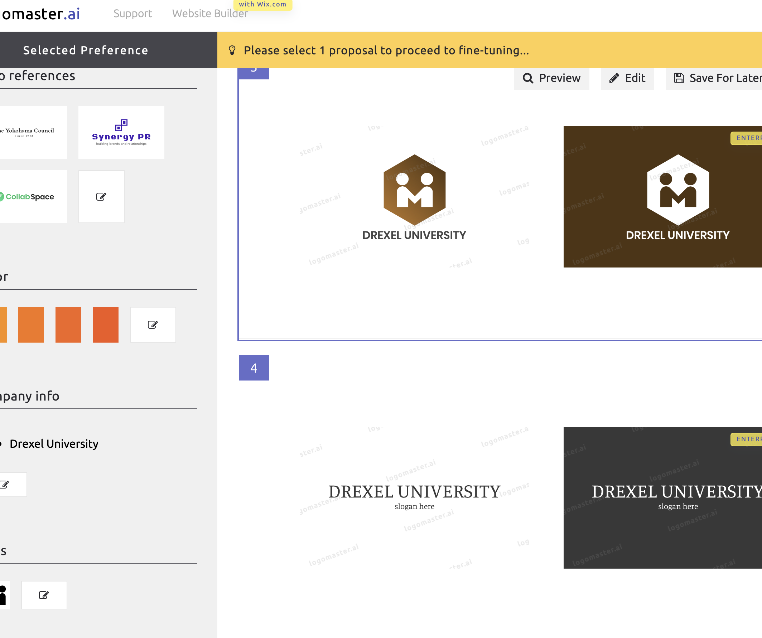
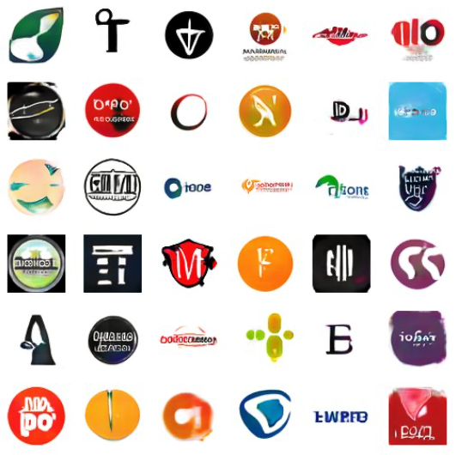
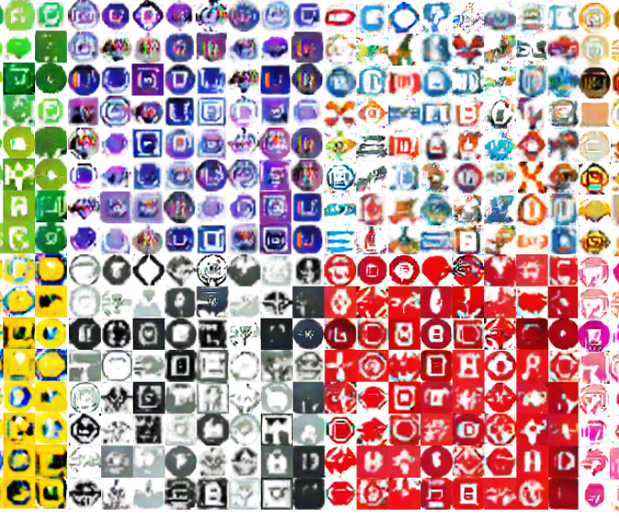
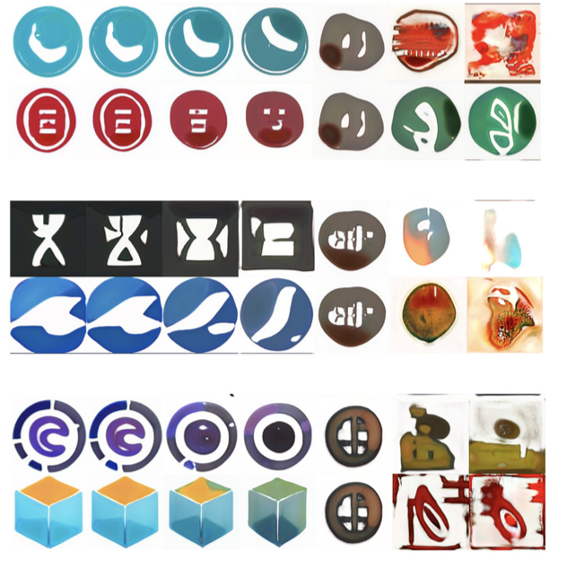
Related Work
There are many websites in the market that allow the user to produce logos (Logomaster.ai)
Logo Synthesis and Manipulation with Clustered Generative Adversarial Networks
LoGAN: Generating Logos with a Generative Adversarial Neural Network Conditioned on Color
LoGANv2: Conditional Style-Based Logo Generation with Generative Adversarial Network
Notes:
Several papers and products have been released to produce logos with the use of AI.
There are many websites in the market that allow the user to produce logos. Logomaster.ai is an example, producing logos based on the company name, logo category, and a series of visual cues. The user is asked to select symbols and colors, and the platform will iterate different layouts. This tool doesn’t consider tone or message and uses a limited set of predefined shapes, but succeeds in implementing a text engine and producing various layouts with the same content.
Logo Synthesis and Manipulation with Clustered Generative Adversarial Networks and LoGAN: Generating Logos with a Generative Adversarial Neural Network Conditioned on Color are two interesting papers that generate logos based on a trained set of images. Logo Synthesis and Manipulation with Clustered Generative Adversarial Networks focuses on a model trained with images scraped from the web to produce a small logo through an interactive interface. LoGAN is a similar algorithm that produces an image based on a trained model, but in this case focusing on twelve color classes. While both of these papers produce interesting images, they focus exclusively on form. The results often are non-representational images which are hard to identify, and the logos are very small and don’t include text. Additionally, LoGAN focuses on color, which is usually reserved for later stages in logo design. LoGANv2: Conditional Style-Based Logo Generation with Generative Adversarial Network is similar to the previous two papers; while the resulting logos still don’t include text and the shapes aren’t always discernible, the results are much closer to usable logos and the resolution of the synthesized logo is higher.

Slide 7
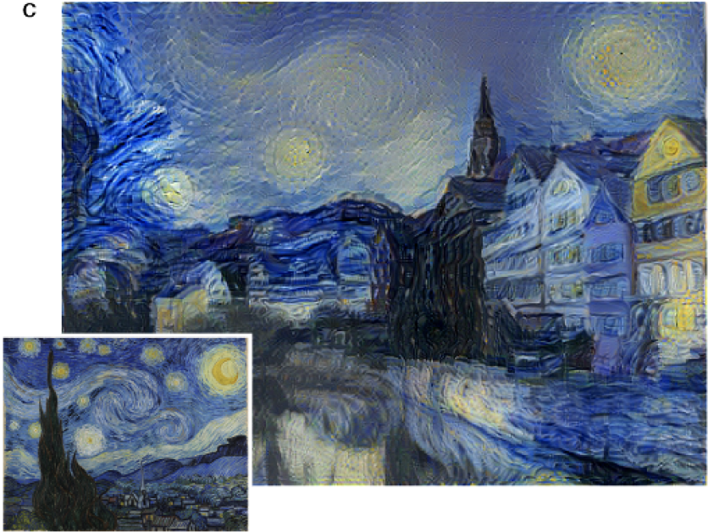
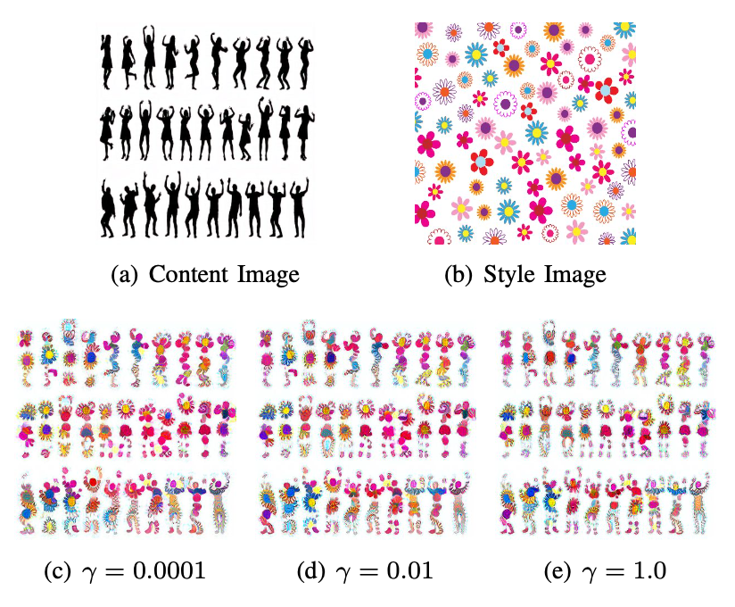
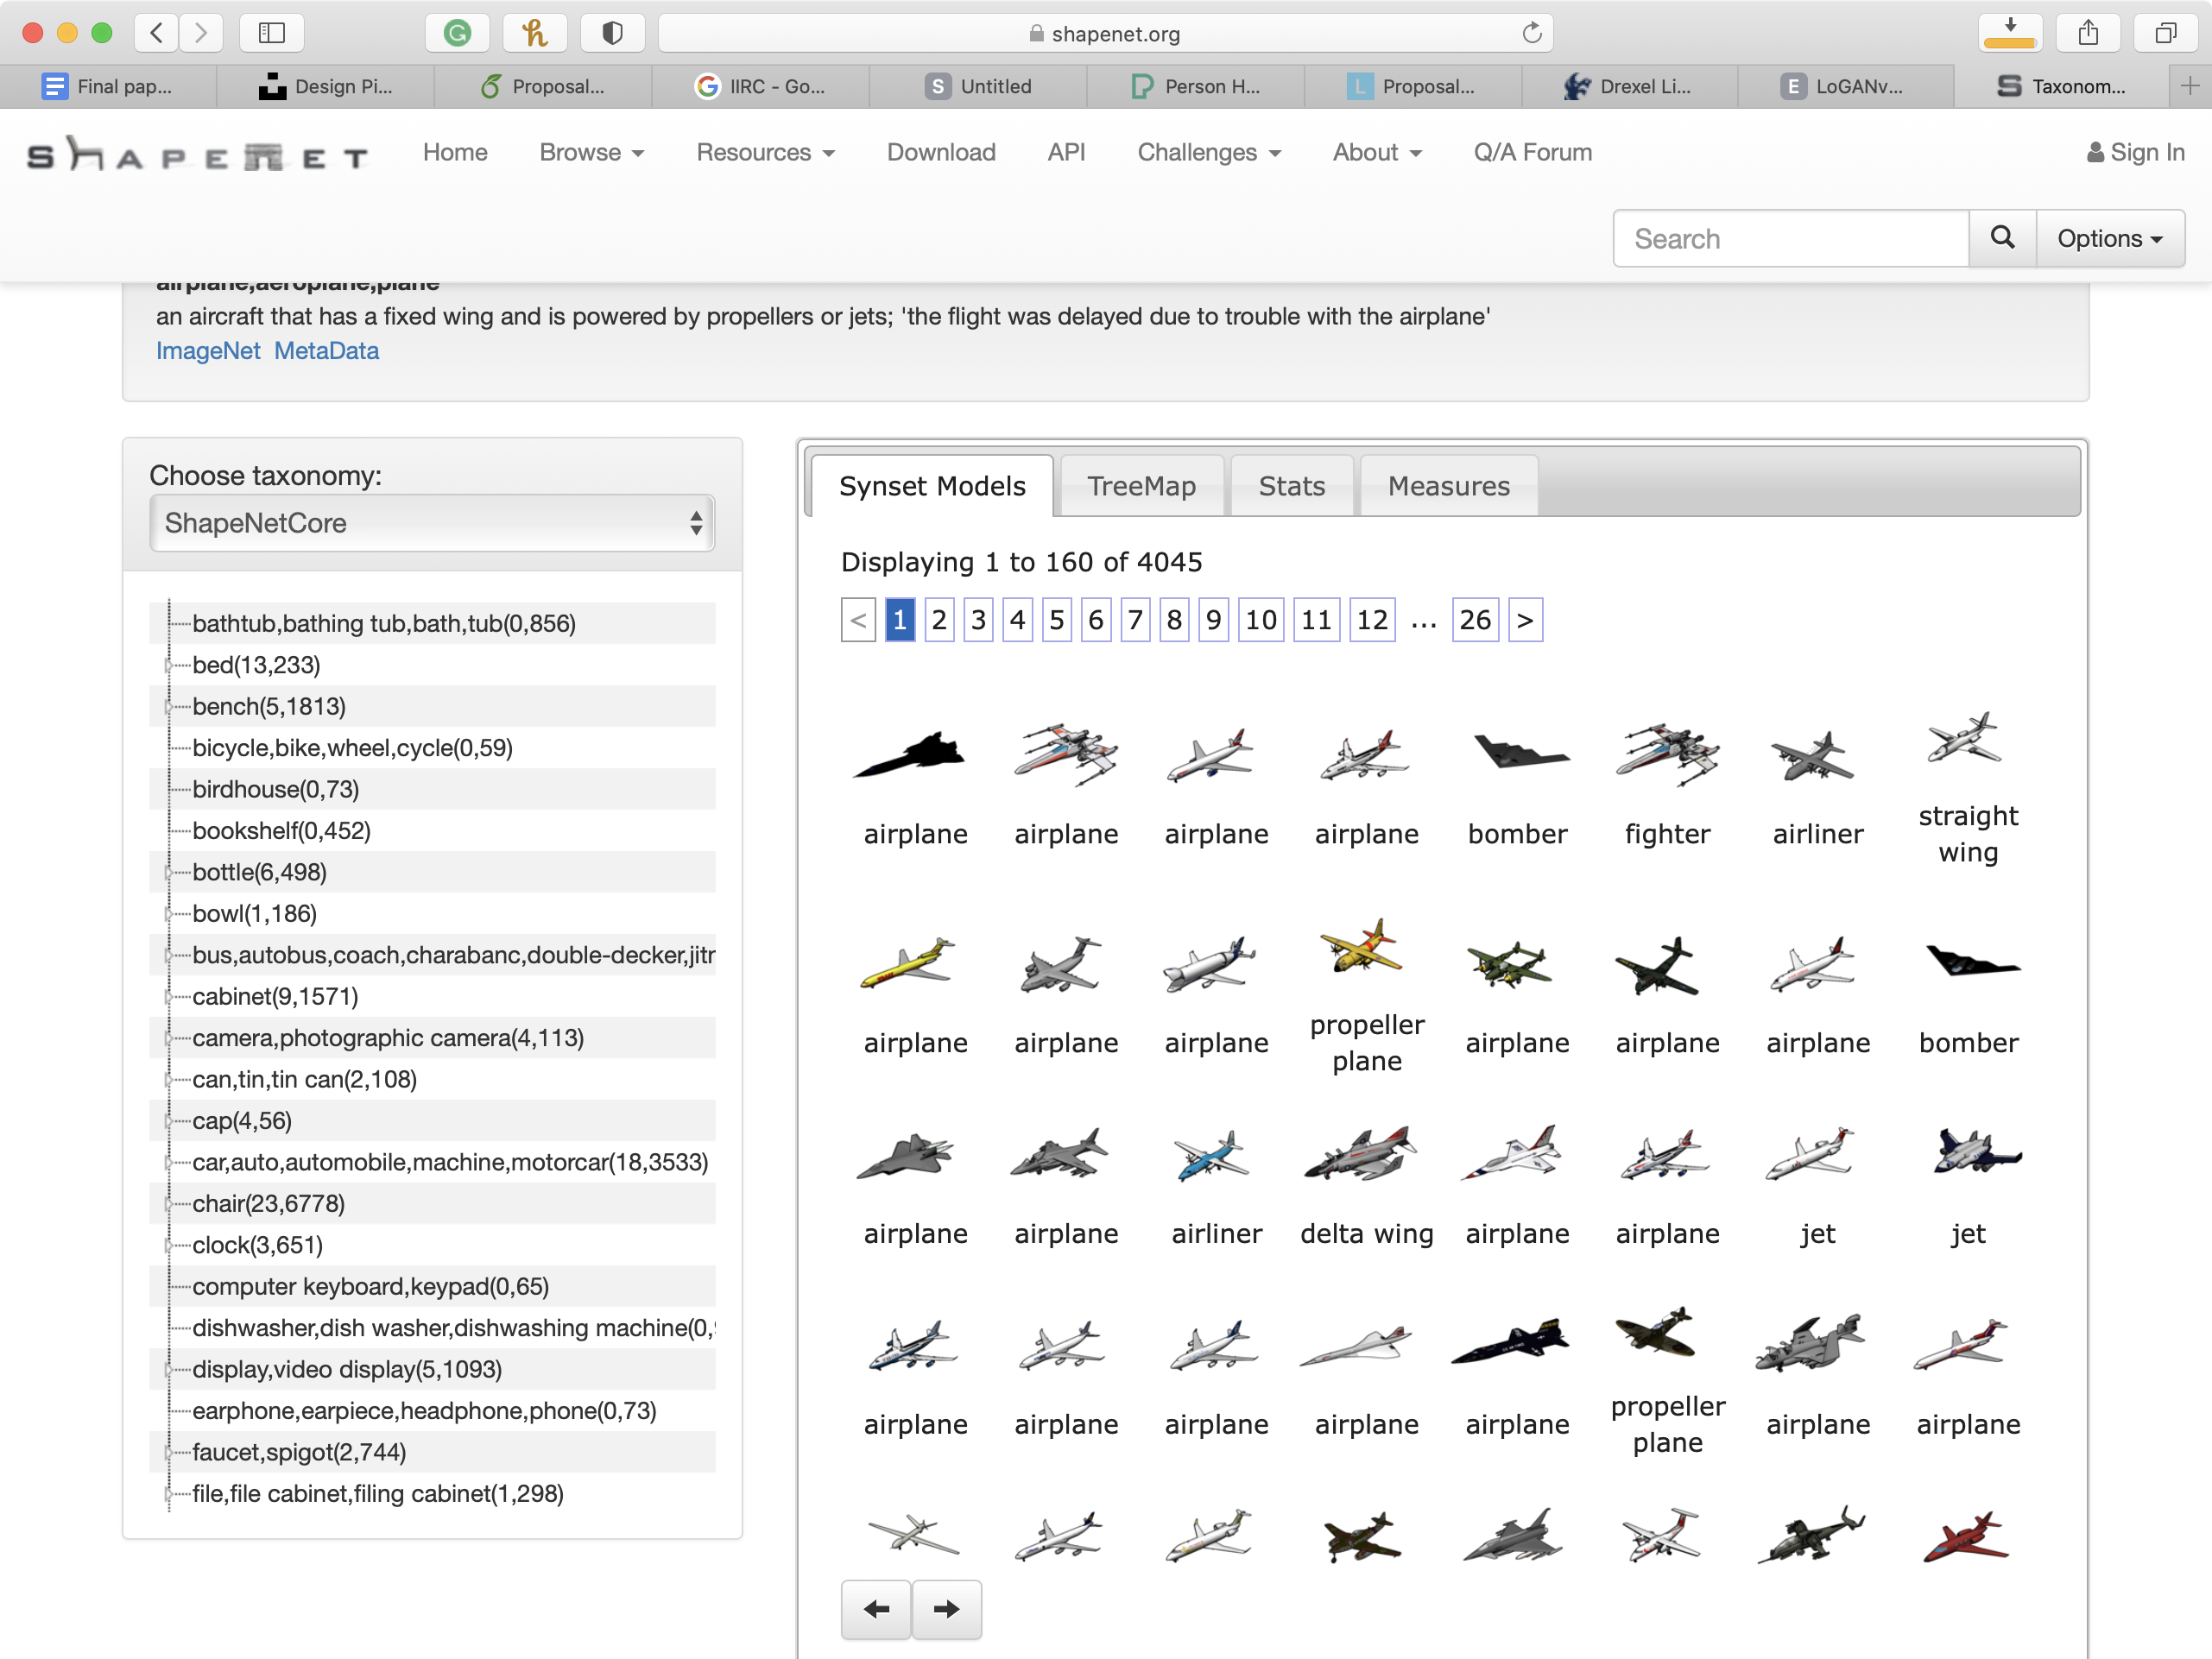
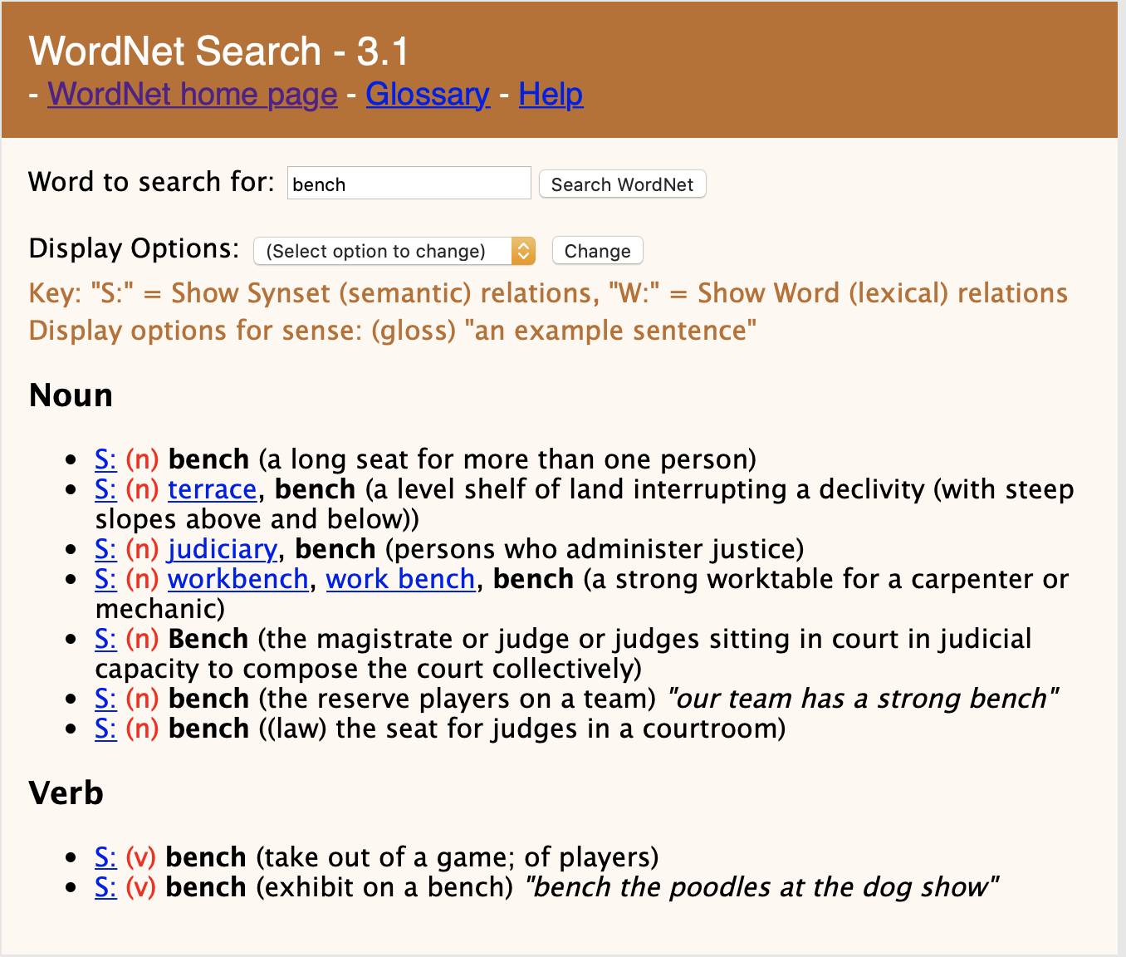
Related Work
A Neural Algorithm of Artistic Style
Constrained Neural Style Transfer for Decorated Logo Generation
ImageNet, ShapeNet, ShapeNetSem
WordNet
Notes:
A Neural Algorithm of Artistic Style focuses on style transfer from one image to another via Convolutional Neural Network that separates content from style. This paper does not cover the design of logos, but this separation of content and style is key to logo design. Constrained Neural Style Transfer for Decorated Logo Generation expands on the idea of transferring style, but specifically for the design of logos, by applying a distance transform loss function that localizes the transfer of styles. The paper claims to produce unique logos, but it focuses strictly on the transfer of style, leaving the design of the symbols or text to the designer. We will leverage style transfer in our system.
In order to produce our logos, we rely on pre-designed shapes for the symbol. Given the time restrictions, we are leveraging pre-trained image sets from ImageNet and ShapeNet. ShapeNetSem is a dataset of 3D models labeled with over 270 categories, from which we ware using prerendered images [shapenet2015, savva2015semgeo]. ImageNet is a very large image dataset frequently used for computer vision research labeled with many synonym sets[ILSVRC15]. We are also using WordNet (WordNet is a a database of English words grouping nouns, verbs, adjectives and adverbs are grouped into of synonyms sets or synsets, Fellbaum).

Slide 8
Contributions
Our process approximates a simplification of the process used by designers to produce logo
Introduce semantics into the logo exploration, via the input of nouns and adjectives
Engine to combine text and image in the logo
Notes:
While we are leveraging various algorithms to produce a proof of concept, our research brings some novelties to the field of generative logo design. The most significant advancement over the previous algorithms is that our process approximates a simplification of the process used by designers to produce logos—the existing algorithms are computationally impressive, but lack design principles to substantiate them. We will also introduce semantics into the logo exploration, via the input of nouns and adjectives, to bring better meaning to the logo generated—as the current options focus primarily on form. Finally, we are introducing an engine to combine text and image in the logo; we see this in other applications where the user selects each component, but we haven’t seen this in algorithms that generate the image.

Slide 9
Methodology
We propose a process for generating logos that better approximates the design process and combines form and content for more meaningful results. We combined and leveraged existing applications to demonstrate the feasibility of using artificial intelligence—with some input from the user—to create logos that are both visually pleasing and deliver the intended message and tone.
Notes:
Designing logos can be time-consuming and expensive. The process involves several steps, from lengthy conversations between the client and the designer, defining the attributes we want to portray, research, various rounds of sketching and developing the logo, presenting several options, narrowing down the selection and editing the logos, etc, until the final logo is produced. Using artificial intelligence could help streamline the process, by intervening in several steps of the process.
As Mino and Spanakis discuss, the area of logo generation hasn’t been explored in length. Additionally, Mino and Spanakis point out several complications in the nature of logos, such as the lack of hierarchy of nested elements and the lack of continuous space—meaning that not all generated logos will be pleasing.
While there are a number of papers on logo generation, we have found that the results are underwhelming and they do not approximate the logo design process. These applications focus exclusively on form and lack any input to inform the messaging, content or symbolic meaning. Additionally, there are design-related complications that these papers haven’t explored.

Slide 10
Methodology
The user will produce a list of terms that will inform the system of the intended message
The system will use an adjective to select the style from a pre-populated, labeled collection of visual style sources.
We use a noun to select an image from a labeled set
If the previous two steps don’t produce a result, we expand the search terms with synonyms from a database
The system will use the visual style source and applies the style transference to our image
We render the company name and combine it with the selected image
Notes:
Our proposed system takes input from the user to identify the attributes they want to represent in the logo. Below is a summary of the process:
The user will produce a list of terms that will inform the system of the intended message
The system will use an adjective to select the style from a pre-populated, labeled collection of visual style sources.
We use a noun to select an image from a labeled set
If the previous two steps don’t produce a result, we expand the search terms with synonyms from a database
The system will uses the visual style source and applies the style transference to our image
We render the company name and combine it with the selected image

Slide 11
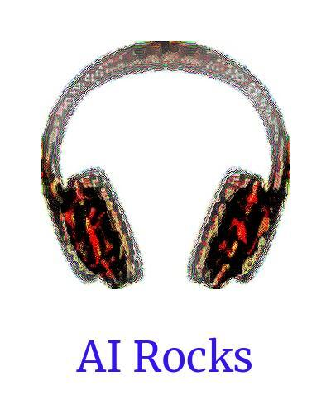
Methodology
Result: a system that can produce simple logos, combining form and meaning
Areas of simplification:
We will focus on pictorial marks
Limited our typeface selection
Single layout and a single iteration
Notes:
The result is a system that can produce simple logos, combining form and meaning. We took some liberties to simplify the process to make the prototype more feasible. For example, Wheeler describes several categories of logos, including wordmarks, letterform marks, pictorial, and abstract; we will focus on pictorial marks (based on literal and recognizable images) and leverage existing labeled image sets. We also limited our typeface selection and asked the user to select some parameters, as selecting a typeface to match tone, message, and form could be its own paper—as Spiekerman and Ginger claim, “picking the right font for a particular message can be fun, but also extremely difficult.” Another aspect we’re simplifying is the choice of a single layout and a single iteration—designers will explore several variants of a design before narrowing down their options, as Connie Birdsall described. Even in this simplified form, we believe that this is a step closer towards producing meaningful logos with artificial intelligence tools.

Slide 12
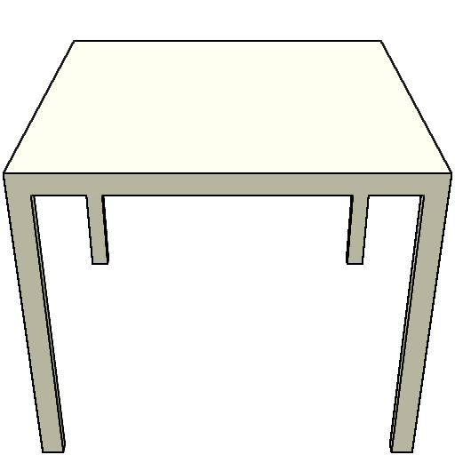
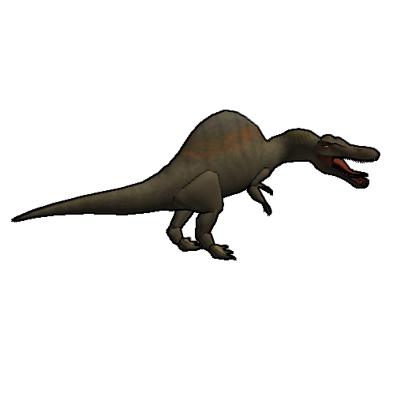
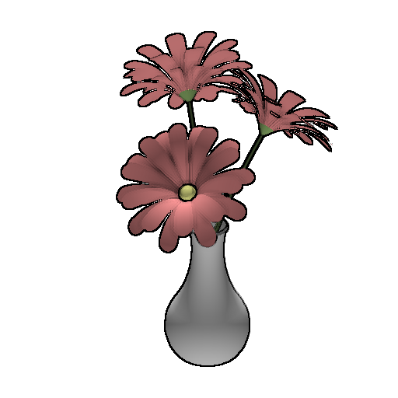
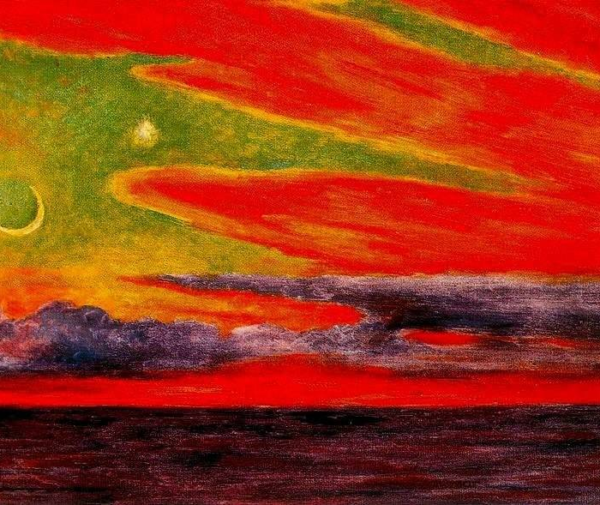
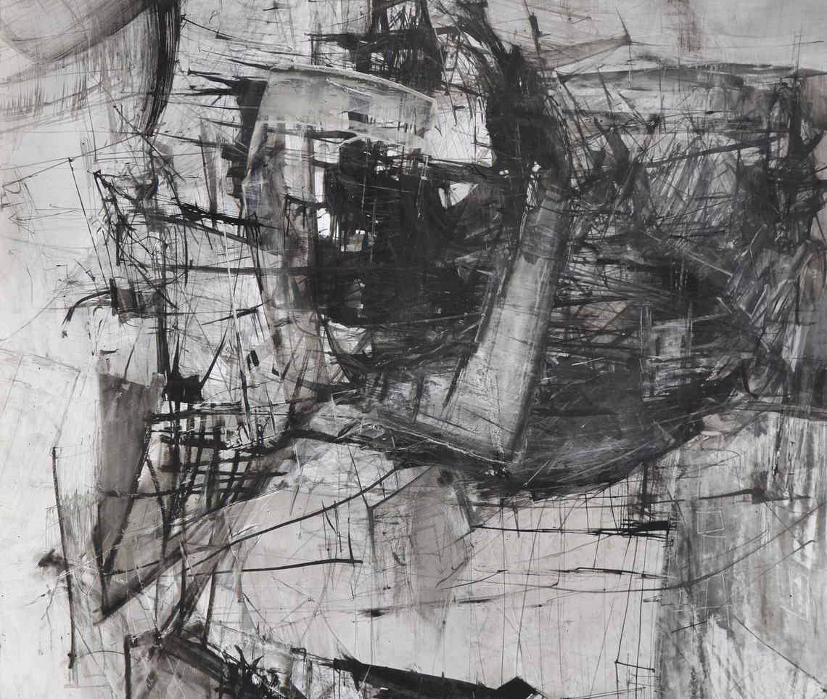
Datasets
Noun dataset from ShapeNetSem
12,000 models
270 labeled categories
Additional labels and metadata
Each object in the dataset has twelve pre-rendered screenshot images
Style dataset
The main source is Kaggle
Some of the images from Google
Notes:
Datasets
Brief spiel about the data sets (will be expanded in the next subsections)
Noun dataset from shapenet(Richard)
For the noun dataset use used the prerendered screenshots from the ShapeNetSem dataset[ [shapenet2015, savva2015semgeo]. ShapeNetSem contains over 12,000 models with 270 labeled categories. Each model also contains additional labels and metadata which we use to match the noun input the user, along with synonym expansion described further below. Each object in the dataset has twelve pre-rendered screenshot images. This gives us the ability to match a broad range of user input for nouns when generating a logo. In fact, we created a reduced subset of ShapeNetSem to make the dataset easier to work with during our research.
Here is an excerpt from the metadata from ShapeNetSem showing the fields available and an example entry:
fullId,category,wnsynset,wnlemmas,up,front,unit,aligned.dims,isContainerLike,surfaceVolume,solidVolume,supportSurfaceArea,weight,staticFrictionForce,name,tags
wss.100f39dce7690f59efb94709f30ce0d2,"Chair,Recliner",n4069540,"recliner,reclining chair,lounger","0\,0\,1","0\,-1\,0",0.012947172227877498,"111.34567\,100.547745\,96.13275",,,,,,,couch,carpet recliner
Style dataset creation (Mohammed)
The main source of the style dataset was a dataset obtained from kaggle [https://www.kaggle.com/ikarus777/best-artworks-of-all-time]. In addition, some of the images were scraped from google to include extra style images that were not found in the dataset, such as zebra and charcoal. The purpose of this dataset is to transfer its style (color) to another image, and in our case it is the logo image.

Slide 13
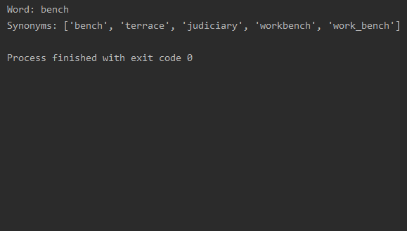
Synonym Expansion
This component uses WordNet to look up for the synonyms set of a word
It helps in expanding the search terms in case of no result was produced.
Notes:
Synonym expansion
To help designers with the process, we developed a component that finds the synonyms for a word. The purpose of this component is to expand the search terms when both terms do not produce a result. For the synonym expansion, we are utilizing the WordNet dataset to find the synonyms set for a word. This is useful because it assists designers to enlarge their scopes in the logo design process.

Slide 14
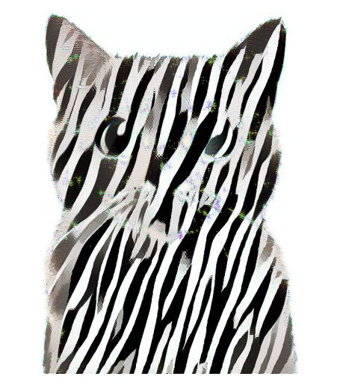
Style Transfer
Constrained Neural Style Transfer for Decorated Logo Generation (CNST
CNNs (Visual Geometry Group Network) to extract content and style representations
Loss function separates content from the background
The authors provided pre-trained weights
We did some additional minor modifications to fit the algorithm into our system
Notes:
To apply the style onto the image, we used the algorithm for Constrained Neural Style Transfer for Decorated Logo Generation (CNST), available at https://github.com/gttugsuu/Constrained-Neural-Style-Transfer-for-Decorated-Logo-Generation. The algorithm uses CNNs (specifically the Visual Geometry Group Network, VGGNet) to extract content and style representations from source images and combine them [CNST].
We chose this algorithm over previous style transfer algorithms (such as A Neural Algorithm of Artistic Style) because CNST includes a loss function that allows it to separate the content from the background [CNST]. CNST generates a distance transform image by assigning a value to each pixel based on proximity; silhouette pixels in the original image are assigned 0 and the rest of the pixels are assigned a higher number the farther they are from these silhouette pixels [CNST]. Then the image is transformed: pixels within the silhouette are assigned 0 and the algorithm applies a weight to the rest. The pixels farther from the silhouette are more likely to be background pixels. The loss function uses this distance image, with a smaller penalty for the pixels closest to the silhouette.
The authors provided pre-trained weights, so we were able to use the algorithm almost out of the box. We had to modify the code to account for Python and Tensorflow versions, and we removed support for GPU processing, as Tensorflow only supports NVIDIA GPUs. We did some additional minor modifications to fit the algorithm into our system.

Slide 15
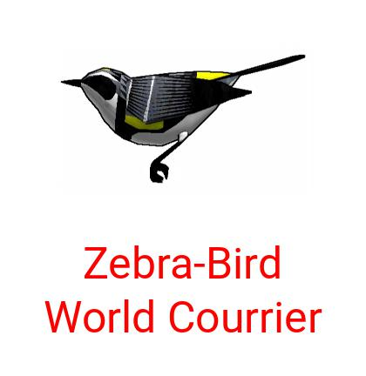
Type Rendering
Simple script that combines an image with text
Limited the layout
We used pillow, a fork of PIL
Load the image
Render the text
Compose them together
General script we can use for any image
We apply the style transfer before using this script
Notes:
We created a simple script that combines an image with text to produce the logo. Since we are building a prototype, we limited the layout to an image at the top and the text at the bottom. The user may choose the alignment (left, right, center), the size of the text, and if the text will fit in one line or break in multiple lines. The user may also choose the color for the text and may choose a limited number of parameters to customize the type (bold, italic, or both; serif, sans serif, or script).
We used pillow, a fork of PIL, to load the image, render the text, and compose them together. First, we load the source image and resize it. We calculate the size for the text we’ll render and then produce a blank image with the right dimensions. We paste the source onto the blank image and render the text.
This is a general script for any image. In our case, we are applying the style transfer before using the text rendering application. We will discuss how these components were combined in the next subsection.

Slide 16
Integration of all Pieces
User enters two terms and adjective for the style image, and a noun for the content image.
System pulls two related images. If terms don’t match, we look for synonyms.
Crop content image
Apply style transfer
Render text
Notes:
The user enters two terms which are used to grab the content and style images from the content and style datasets. The first term is for the style image, and the second one is for the content image. Whether one or both of the terms is not found, the system looks up for the synonyms and then iterates over them. If one of the synonyms is found in the dataset, then the system returns that synonym to retrieve the images from the dataset.
To combine the content image, style image, and text, we wrote a few components. First, we select the source content and style image based on text input from the user (and if there isn’t a direct match, we find synonyms) that will be used to form the graphic for our logo. Then we crop the content image to remove extraneous white or transparent content around it and then save it to a white square; this maximizes the area to apply the style and sets the image to the right format for the style transfer. The style transfer was taken from a published paper, but we made minor customizations for our system. At the end, we render the text with some input from the user. The result will be a logo with a styled image and text.

Slide 17
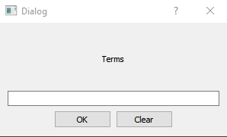
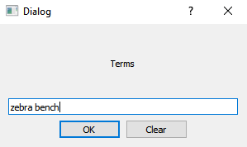
Integration of all Pieces
We built a prototype UI that integrates all the components to ease the process.
It takes a pair of words as an input to select images from the labeled datasets.
Notes:
We developed a prototype UI that integrates all of the components together to ease the process of generating a logo. It takes a pair of a noun and an adjective as an input to fetch the corresponded images from the labeled datasets. The system allows the user to choose from 9 images for each term, and also the user has an option to reroll to retrieve new images. The system then transfers the style from the style image into the content image without losing the important features of the content image. This process takes from 2 to 4 hours, depending on the hardware. After finishing the style transfer step, the system will allow the user to enter a text (e.g. Company name) to combine it with the generated logo. The user may enter some arguments to modify the text, and may preview the text-image pair before committing to it.
(split this over the next few slldes)

Slide 18
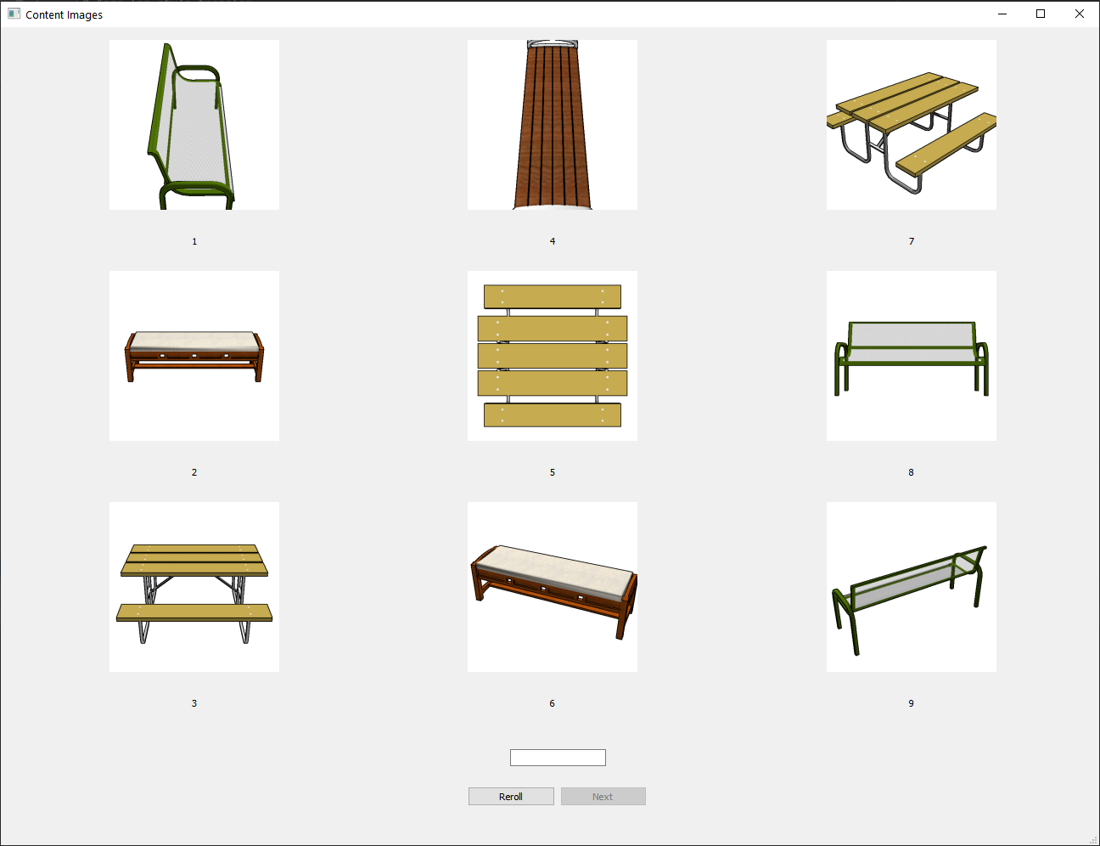
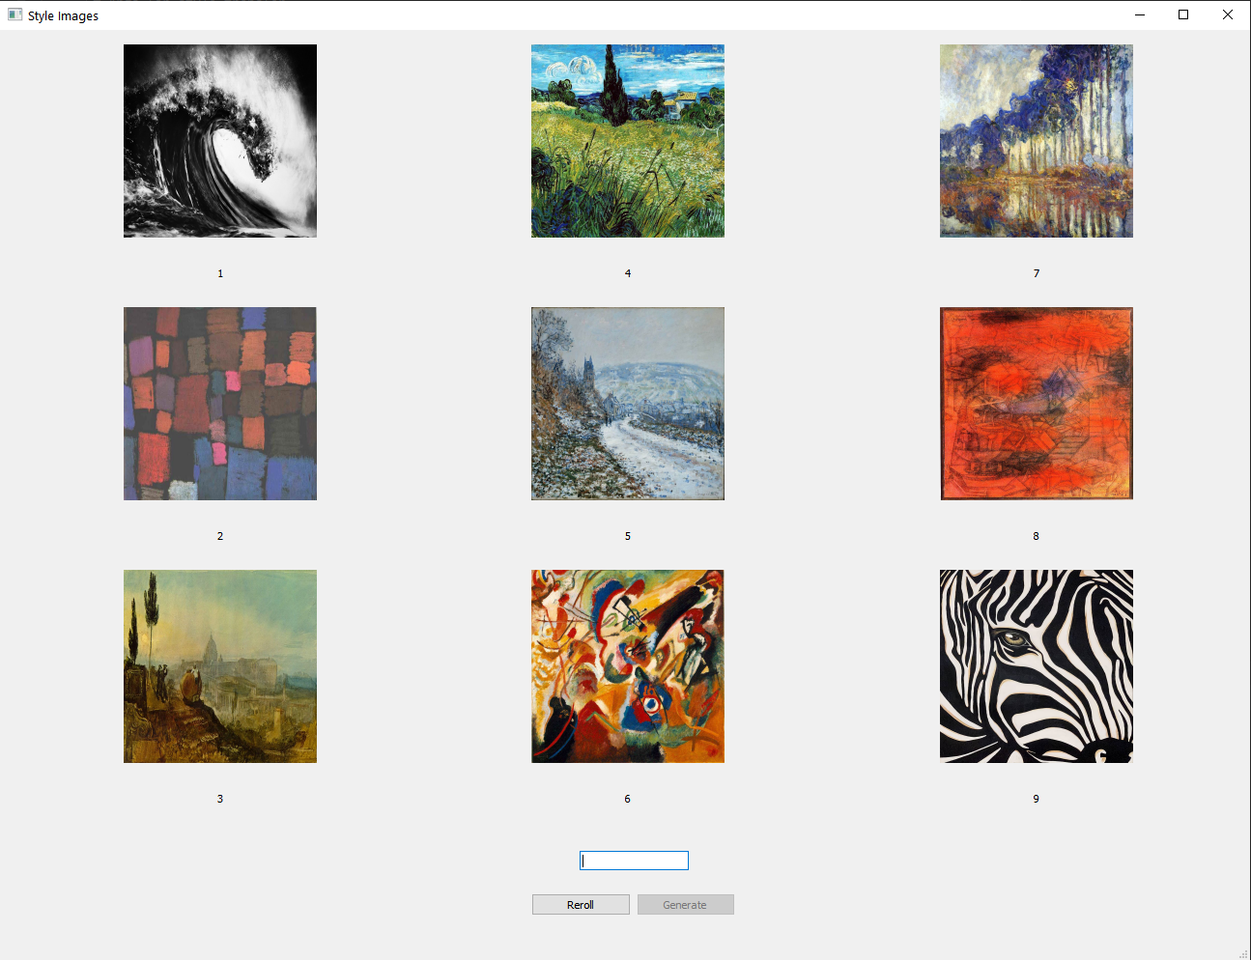
Integration of all Pieces
Select the content image from the list of content images.
Select the style image from the style images.
Reroll if the desired image is not found in the populated list.
Notes:
The system displays 9 images for each term and allows the user to choose. If the user does not find the desired image, the user can reroll to fetch new images.

Slide 19
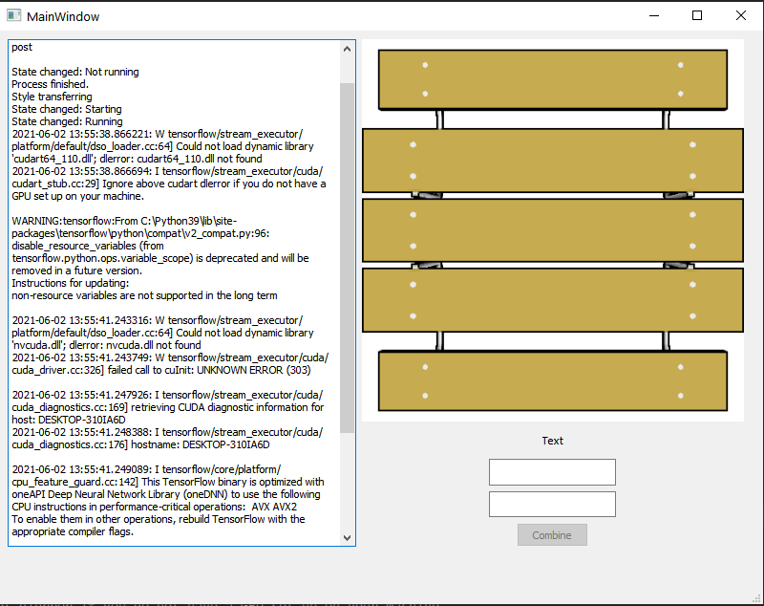
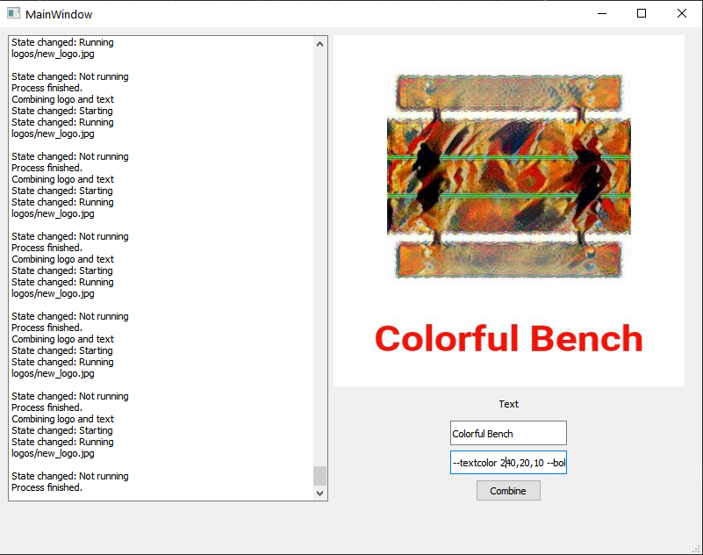
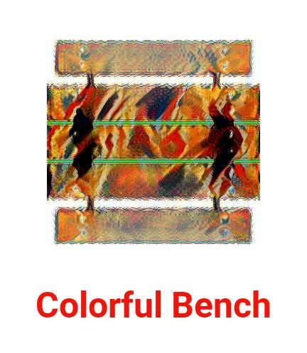
Integration of all Pieces
Generate a logo by transferring the style from the style image into the content image.
Combine the generated logo with the entered text.
Notes:
The system transfers the style from the style image into the content image while keeping the important features of the content image. After finish this step, the system allows the user to enter a text to combine with the generated logo.

Slide 20
Integration of all Pieces
Simple script that combines an image with text
Limited the layout
We used pillow, a fork of PIL
Load the image
Render the text
Compose them together
General script we can use for any image
We apply the style transfer before using this script
v
Notes:
We created a simple script that combines an image with text to produce the logo. Since we are building a prototype, we limited the layout to an image at the top and the text at the bottom. The user may choose the alignment (left, right, center), the size of the text, and if the text will fit in one line or break in multiple lines. The user may also choose the color for the text and may choose a limited number of parameters to customize the type (bold, italic, or both; serif, sans serif, or script).
We used pillow, a fork of PIL, to load the image, render the text, and compose them together. First, we load the source image and resize it. We calculate the size for the text we’ll render and then produce a blank image with the right dimensions. We paste the source onto the blank image and render the text.
This is a general script we can use for any image. In our case, we are applying the style transfer before using the type rendering application. We will discuss how these components were combined in the next subsection.

Slide 21
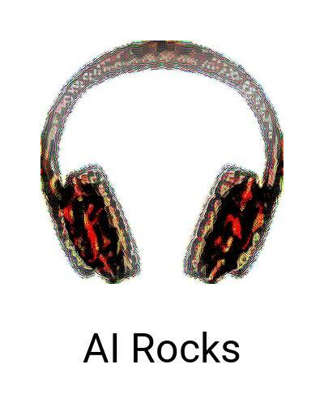
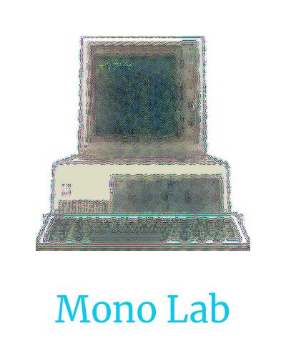
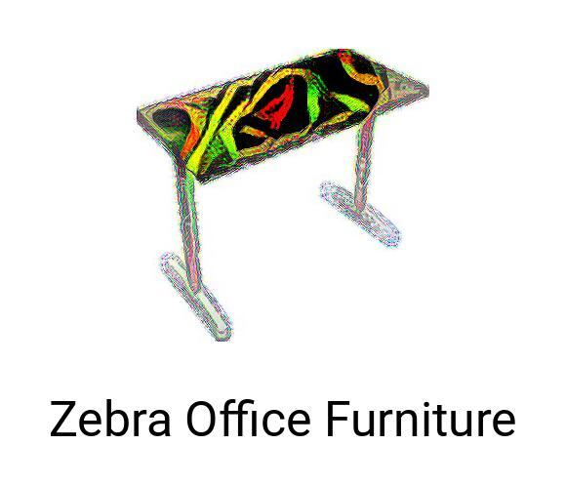
Results
Notes:
To run our tests, we entered pairs of nouns and adjectives into the system. Each iteration took 2 – 4 hours to produce a logo, mainly because the style transfer is computationally expensive, sowe were only able to run a limited number of tests.
For the noun and adjective pairs, we entered several combinations, and the system was successful in finding relevant matches or producing synonyms to approximate the desired results. The system is more successful in finding nouns than adjectives, but with more labeling we can improve the adjective images.
The style transfer algorithm produced great results. The algorithm produces better results with simple shapes that include larger masses where the style can be applied, but it produces satisfactory results with outlined shapes. When combined with text, the logos were interesting, appealing, and were both recognizable and usable.
Overall, we think our system was effective in taking a pair of words and producing a usable logo. More importantly, we saw that by approximating the design process, we were able to use higher-quality logos than previous AI systems—factoring both semantics and the completeness of the image and text combinations. We believe that our results demonstrate that we can use AI to create meaningful logos and approximate the logo design process.
(split over results slides)

Slide 22
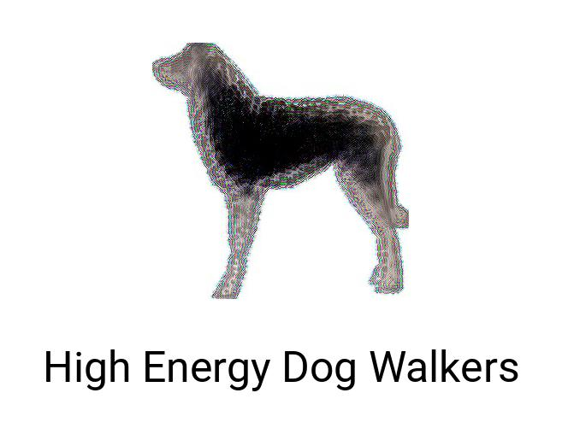
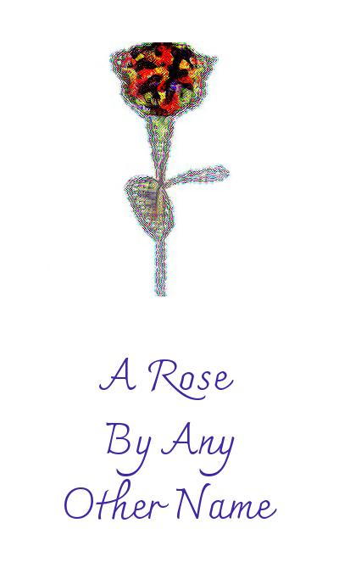
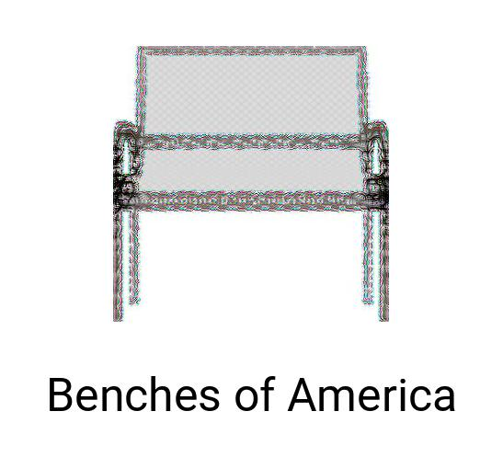
Results

Slide 23
Conclusions
We are able to produce usable logos with input from the user to inject message and meaning
Our system shows a simplified process for logo creation
It is possible to use AI to approximate the design process to generate meaningful logos
The logos are representational and identifiable
Notes:
We are pleased with the results of our research and our prototype for implementation. As we saw in the previous sections, we are able to produce usable logos with input from the user to inject message and meaning. Our system shows a simplified process for logo creation, which still has room for improvement and to add features that will bring it closer to the process designers use when creating logos, but it shows that it is possible to use AI to approximate the design process to generate meaningful logos.
We saw that using keywords as input from the user, rather than a set of images with little regard for semantics, helped produce a system where the logos are representational and meaningful. Combined with a trained set of source images, the logos are representational and identifiable, which is not true for other logo generation papers we’ve explored.

Slide 24
Conclusions
Style transfer allows to customize the image, and both improve the aesthetic value and to make the logo more unique
Using labeled datasets is a good way to produce a large space for images.
Using text input helps us identify some attributes that the client will want to see reflected in the logo
Notes:
We also saw that using style transfer allows us to customize the image and both improve the aesthetic value and to make the logo more unique.
Using labeled datasets is a good way to produce a large space for images, similar to what we saw in some online logo generators. Unlike the online logo generators, using text input helps us identify some attributes that the client will want to see reflected in the logo—which is a more nuanced and sophisticated parameter than asking the user to select an icon from a set.

Slide 25
Future Work
Testing
Better GPU Support
Moodboard as input
Text and Layout Iteration
Custom Dataset
Color
Notes:
Testing
While we are happy with the results, and we believe these logos show a vast improvement in the process of logo creation, time constraints didn’t allow us to produce or implement tests. One way we could do this is to produce a series of logos with the system and create a survey where we ask respondents to evaluate how closely the logos match the words picked to produce them. If a high number of respondents rate the word-logo pairing highly, we can accept that the system satisfies our goals.
Better GPU Support
The style transfer algorithm is the most time-consuming and computationally expensive component of the system. Because it relies on Tensorflow, the use of GPU is limited to NVIDIA GPUs, so we had to rely on the slower CPU processing. We would like to explore other options that allow for different GPUs to be used to expedite the process.
Moodboard as input
Most designers start their design process with a moodboard—a collection of images arranged on a page to summarize their visual research. A future iteration of our research could take a moodboard as input, then detect shapes and styles to combine them through the style transfer algorithm. This would help us get closer to the design process.
Text and Layout Iteration
Our system uses a limited number of typefaces and one layout (image on top, text below it). Additionally, each run produces a single typeface in one variant (regular, bold, italic, or bold italic). This paper can be expanded by iterating various layouts with different typefaces.
Custom Dataset
Since our focus with this paper was to produce a prototype that demonstrates that we can approximate the design process with AI, we leveraged pre-trained datasets for content and style images and to produce synonyms. Given more time and resources, it would be helpful to produce a custom dataset, possibly with proprietary images both for content and style.
Color
In our system, the color comes from the style source and is transferred to the content image without transformation. The user is able to select the color for text, but they have to manually select it and specify it. In our preliminary research, we found that color selection and application are two topics that could take their own papers, so we decided to save that for a later iteration. A future contribution to this research could involve using AI to produce a color palette and then to transfer it to the image and text.

Slide 26
References
Agustsson, E.; Sage, A.; Timofte; Van Gool, L. 2017. Logo Synthesis and Manipulation with Clustered Generative Adversarial Networks. Ithaca, NY: Cornell University. arXiv:1712.04407v1.
Atarsaikhan, G.; Iwana, B.K.; and Uchida, S. 2018. Constrained Neural Style Transfer for Decorated Logo Generation. Ithaca, NY: Cornell University. arXiv:1803.00686v2.
Bethge, M; Ecker, A.S.; and Gatys, A.L. 2016. A Neural Algorithm of Artistic Style. Journal of Vision 16(12): 326-. arXiv:1508.06576v2.
Birdsall, C, 2008. Corporate Identity. The Essential Principles of Graphic Design. Edited by Debbie Millman. Cincinnati, Ohio: How Books.
Chang, A, et al, 2015. ShapeNet: An Information-Rich 3D Model Repository. Stanford University --- Princeton University --- Toyota Technological Institute at Chicago.
Chang A.; Hanrahan, P; Savva, M. 2015. Semantically-Enriched 3D Models for Common-sense Knowledge. CVPR 2015 Workshop on Functionality, Physics, Intentionality and Causality.
Fellbaum, C. 1998. WordNet: An Electronic Lexical Database. Cambridge, MA: MIT Press
Ginger, E.M., and Spiekermann, E. 2003. Stop Stealing Sheep & Find Out How Type Works. Berkeley, California: Peachpit Press.
Mino, A., and Spanakis, G. 2018. LoGAN: Generating Logos with a Generative Adversarial Neural Network Conditioned on Color. In proceedings of the 17th IEEE International Conference on Machine Learning and Applications. arXiv:1810.10395v1.
Napoles, V, 1988.Corporate Identity Design. New York: John Wiley & Sons, Inc.
Russakovsky, O, et al, 2015. ImageNet Large Scale Visual Recognition Challenge. International Journal of Computer Vision (IJCV) 115(3): 211-252. 10.1007/s11263-015-0816-y
Wheeler, A. 2003. Designing Brand Identity. Hoboken, New Jersey: John Wiley & Sons.
Notes:
We are pleased with the results of our research and our prototype for implementation. As we saw in the previous sections, we are able to produce usable logos with input from the user to inject message and meaning. Our system shows a simplified process for logo creation, which still has room for improvement and to add features that will bring it closer to the process designers use when creating logos, but it shows that it is possible to use AI to approximate the design process to generate meaningful logos.
We saw that using keywords, as input from the user, rather than a set of images with little regard for semantics, helped produce a system where the logos are representational and meaningful. Combined with a trained set of source images, the logos are representational and identifiable, which is not true for other logo generation papers we’ve explored. We also saw that using style transfer allows us to customize the image and both improve the aesthetic value and to make the logo more unique.
Using labeled datasets is a good way to produce a large space for images, similar to what we saw in some online logo generators. Unlike the online logo generators, using text input helps us identify some attributes that the client will want to see reflected in the logo—which is a more nuanced and sophisticated parameter than asking the user to select an icon from a set.

